Slide 1
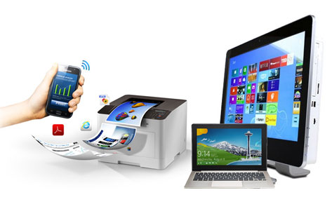
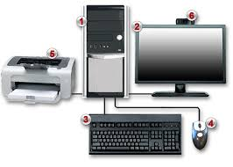
Fundamentals Computer Systems
Lecture 1 – Chapter 1
(Understand The Functions Of Computer System)
Dhanusha Somawardhana
Bsc(Hons) IT (SLIIT), MBA (Uow)

Slide 2
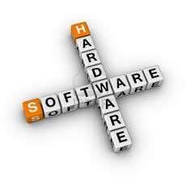
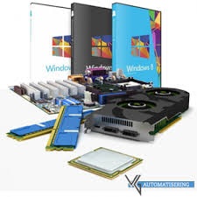
What is a Computer System?
Working computer. Computer systems - The computer along with any software and peripheral devices.

Slide 3
Interesting Facts about Computers
Do you enjoy playing video games? Well there are two games that were the first ever made in the US called Asteroids and Lunar Lander in 1980.
HP, Google, Microsoft and Apple all started out of garages.
Only about 10% of the world’s currency is physical money, the rest only exists on computers.
Doug Engelbart invented the first computer mouse in around 1964 which was made of wood.
The first 1GB hard disk drive was announced in 1980 which weighed about 550 pounds, and had a price tag of $40,000.

Slide 4
Generation of Computers – 1st Generation
The beginning of commercial computer - UNIVAC (Universal Automatic Computer)
Developed by two scientists Mauchly and Echert at the Census Department of United States in 1947.
Based on vacuum tubes – (Vacuum tube as a signal amplifier, a typical first-generation computer. Initially, vacuum tube is used as a component of the signal amplifier).
Vacuum tube technology made possible to make electronic digital computers.
Raw materials consist of glass.
Low Speed and Large in Size.

Slide 5
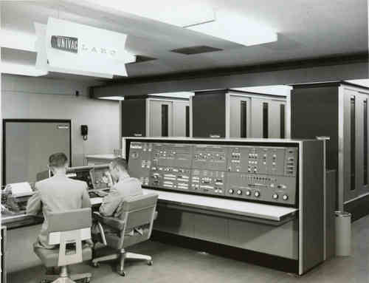
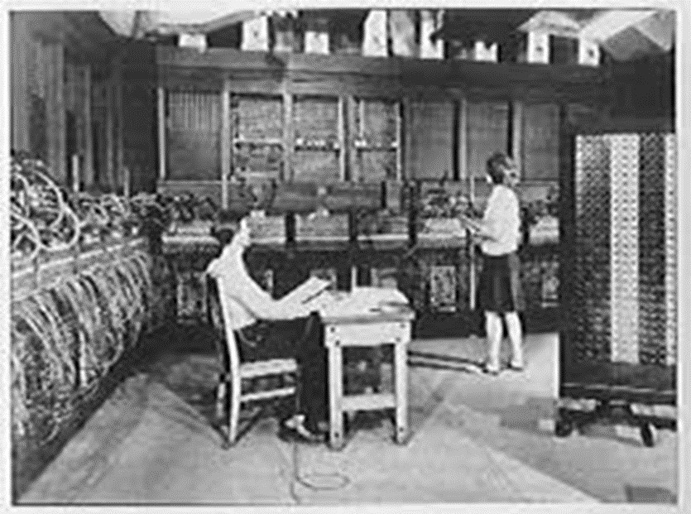
Contd.
World's first electronic computer that has a weight weighing 30 tons, length 30 M and 2.4 M high and requires 174 kilowatts of electrical power.
Magnetic drums which provide very less data storage and Punch Cards for inputs

Slide 6
2nd Generation (1955-1964)
The second generation computers used transistors.
Raw material consists of 3 layers, namely: "basic" , "collector" and "emmiter"
Scientists - John Barden, William Brattain and William Shockley
Replacing vacuum tubes with transistors.
Ex: IBM 7094 series, IBM 1400 series and CDC 164
Smaller Size and Less Power Consumption.
Wider Use and Better Computing Power.
Punch Card Input
Difficult in Commercially Implementation, But this computer is designed to solve all kinds of jobs both scientific and commercial.

Slide 7
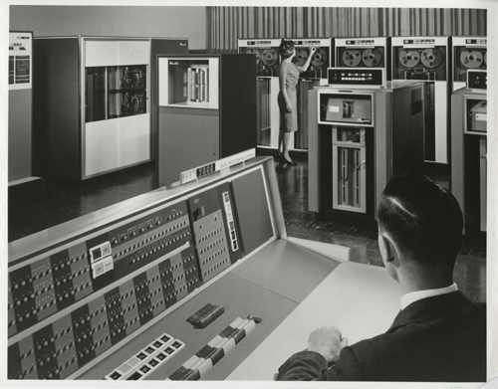
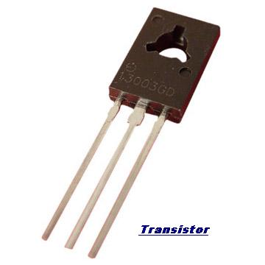
Cont.

Slide 8
3rd Generation (1964-1975)
Third generation computers used the integrated circuits (IC).
Size of an IC is about ¼ square inch and contain thousands of transistors.
Ex: IBM 370, IBM System/360, UNIVAC 1108 and UNIVAC AC 9000
Small sized, More reliable, Better Speed and Less costs
Used mouse and keyboard for input.

Slide 9
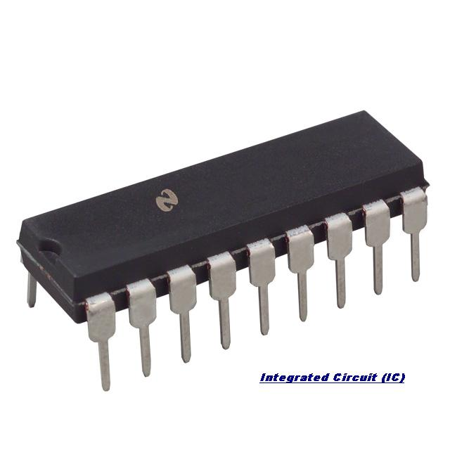
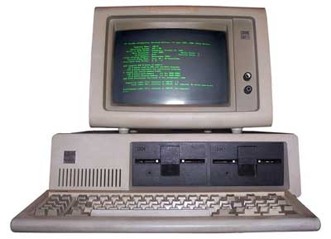
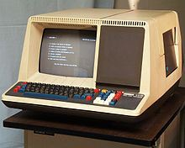
Cont.
Computers are used to automate first introduced in 1968 by PDC 808, which has 4 KB (kilo-byte) memory and 8 bits for core memory
Needed Air Conditioning
Required Highly sophisticated technology for the manufacturing of IC chips.

Slide 10
4th Generation (1975-Present)
Started with the invention of Microprocessor.
Microprocessor contains thousands of ICs
Ted Hoff produced the first microprocessor in 1971 for Intel.
Ex: Apple Macintosh & IBM PC.
Powerful, Reliable, Less Cost and Small Sized
Requires Advanced Technology

Slide 11
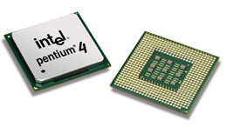
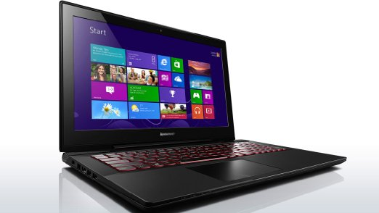
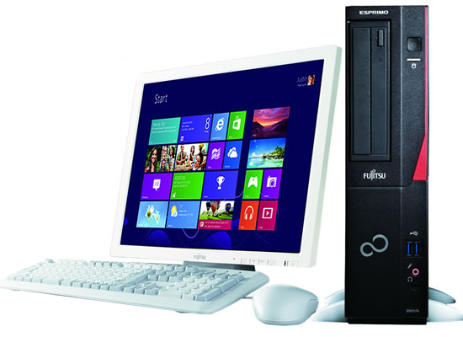
Cont.

Slide 12
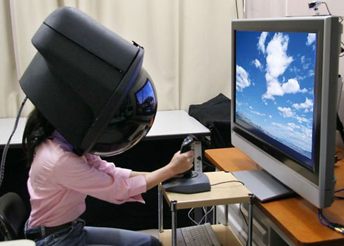
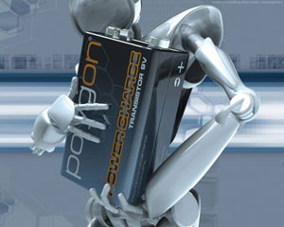
5th Generation (Present to Future)
Based on the technique of Artificial Intelligence (AI).
Computers understand spoken words & imitate human reasoning.
Very High Processing Power.
Advanced Technologies.

Slide 13
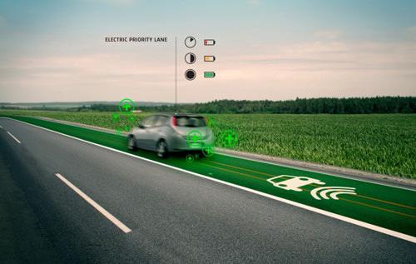
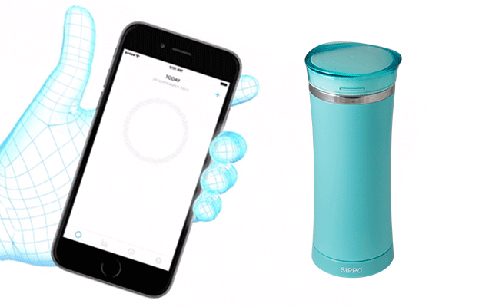
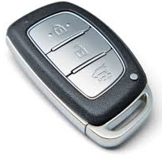
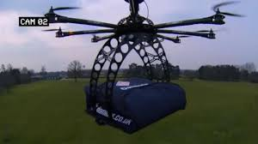
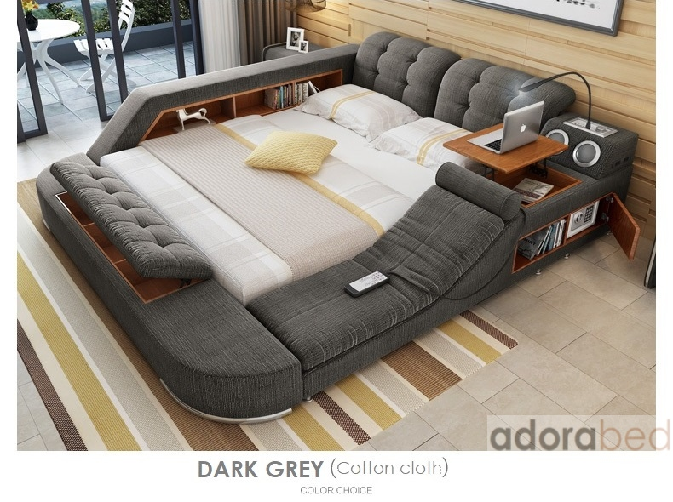
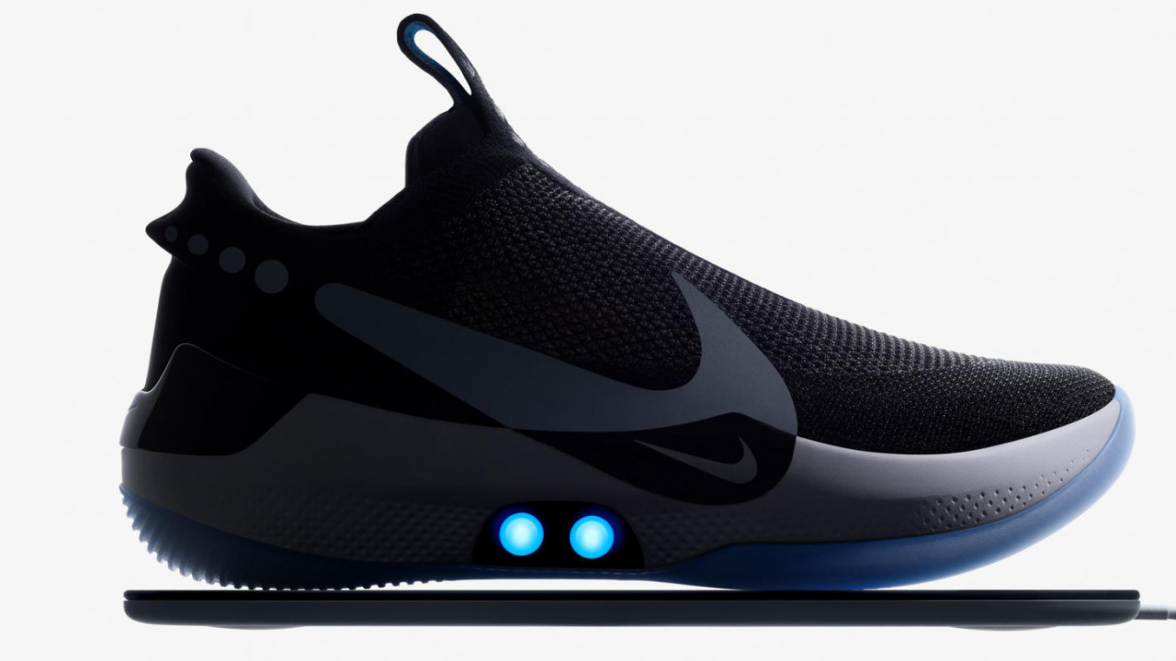
Artificial Intelligence
Notes:
Smart Road

Slide 14
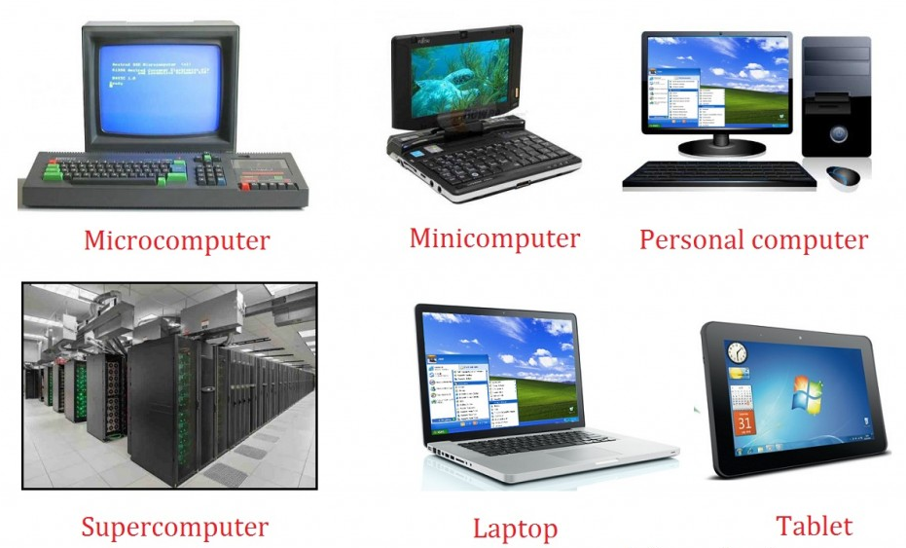
Types of Computers
Super Computers
Mainframe Computers
Mini Computers
Micro Computers

Slide 15
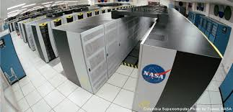
Super Computers
Performs at or near the currently highest operational rate for computers.
For -
Earth Quick Studies
Weather Forecasting
Nuclear Weapon Testing
Space Exploration
For critical systems
Popular Supercomputers
Fujitsu’s K Computer in Japan
IBM’s SuperMUC in Germany

Slide 16
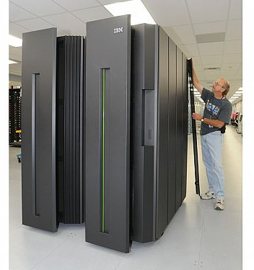
Mainframe Computers
Not as powerful as supercomputers.
Used by large organizations for there work.
Process & store large amount of data.

Slide 17
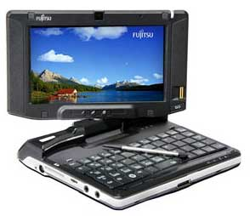
Mini Computers
Used by small businesses & firms.
Can cater for multiple users at a time.
Small machines and not high capable as super computers or mainframe computers.
Designed for specific purposes.
Ex: Texas Instrument TI-990, IBM Mid Range

Slide 18
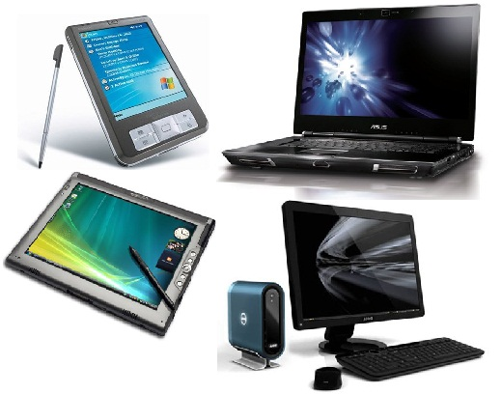
Micro Computers
Desktop computers, laptops, personal digital assistant (PDA), tablets & smartphones.
Widely used & the fastest growing.
For general usage like entertainment, education and work purposes.
Manufacturers - Dell, Apple, Samsung, Sony & Toshiba.

Slide 19
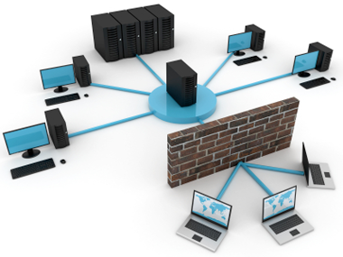
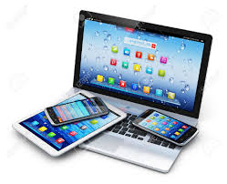

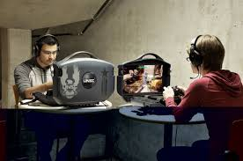
Types of Environments
Home
Business
Gaming
Networking
Real Time
Communication

Slide 20
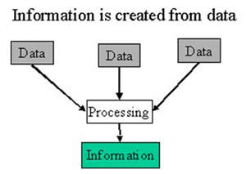
Basic Terms
Data, Program and Information
Software and Hardware

Slide 21
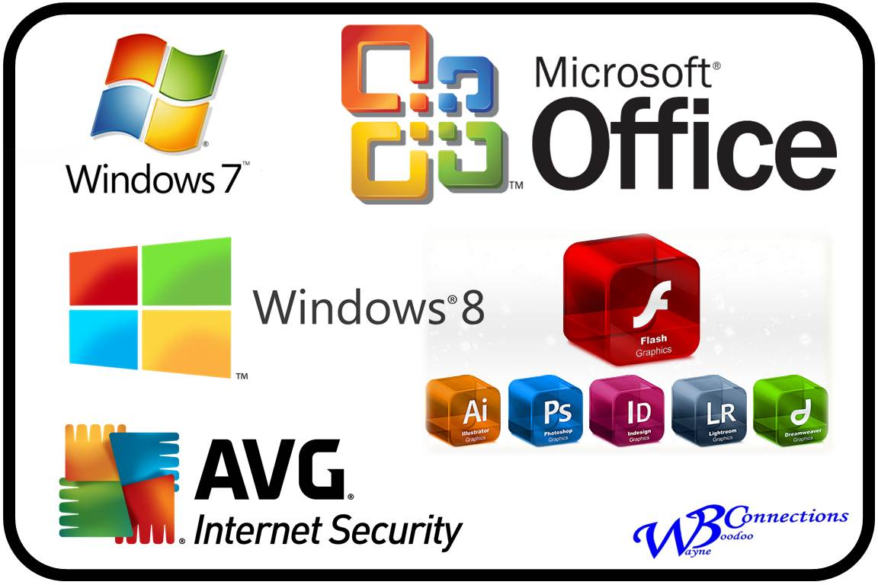

Software
Types of S/W Systems –
Generic Software
Bespoke Software
Types of Software
Application S/W
System S/W – OS, Compilers, Translators
Scientific and Engineering S/W
Web Software
Artificial Intelligent S/W
Library Programs

Slide 22
Numerical Conversions
Binary Numbering System
Octal Numbering System
Hexadecimal Numbering System

Slide 23
Binary Numbering System
It converts the numeric data input to its corresponding binary equivalent.
Performs the desired arithmetic operation in binary.
Converts the result back to its corresponding decimal equivalent and outputs the result.
Uses only 1 and 0
Decimal to Binary
5 - 0101

Slide 24
Octal Numbering System
Numbers Based 8.
Octal is used as a shorthand for representing file permissions on UNIX systems.
Numbers from 0 – 7
Ex : - Decimal 100 = Octal 144 (1448)

Slide 25
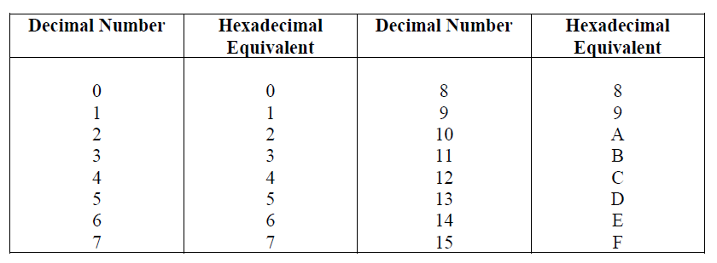
Hexadecimal Numbering System
Numbers based on 16
Hexadecimal system is commonly used by programmers to describe locations in memory

Slide 26
Contd.
Ex: 140 Decimal – 8C16

Slide 27
More Conversation
Binary to Octal
Binary to Hexa-Decimal
Octal to Binary
Hexa-Decimal to Binary
Octal to Hexa-Decimal

Slide 28
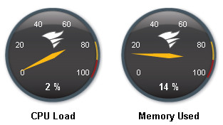
Performance Factors
Performance and Efficiency
MIPS – Million Instructions Per Second
Clock Speed – Speed which Micro Processor executes the instructions.
Bus Architecture - How much data can be transferred through the bus.
FLOPS (Floating point operations per second) – Measurement for the speed of the micro processor

Slide 29
Thank You…!!!

